Slide 1
Hypothesis Test: Means
Chapter 22 Hyp Test

Slide 2

Quantitative Data
Population Parameters
Sample Statistics
$μ=\text{mean}$
$σ=\text{standard} \text{deviation}$
$\overline{x}=\text{mean}$
$s_{x}=\text{standard} \text{deviation}$

Slide 3
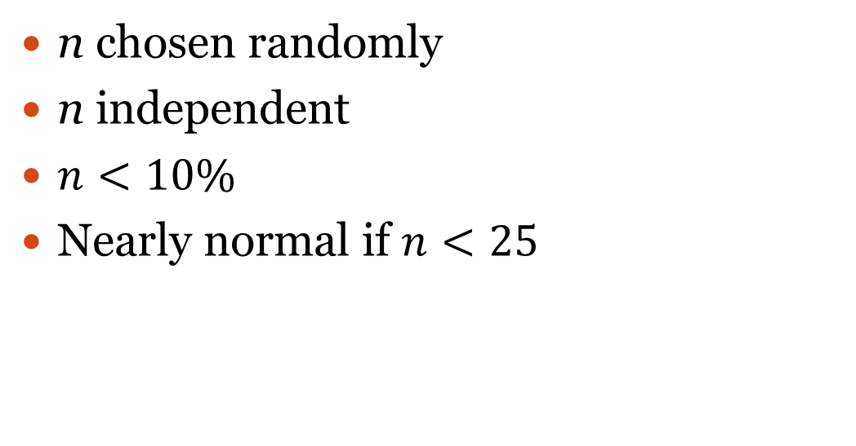
Assumptions/Conditions
n chosen randomly
n independent
$n<10\%$
Nearly normal if $n<25$
n = sample size

Slide 4
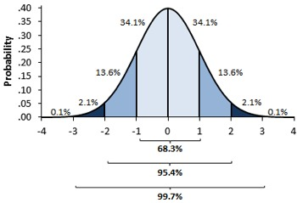
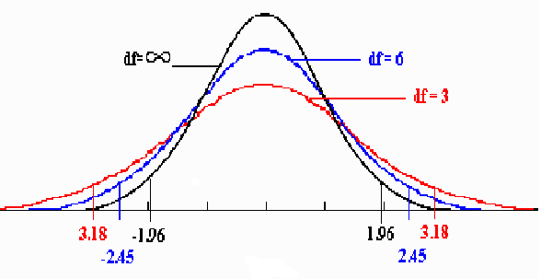
Z vs T
z- distribution
t-distribution
Use when σ is unknown
Degrees of freedom =$n−1$
Use when σ is known

Slide 5
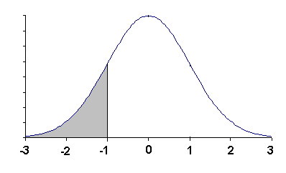
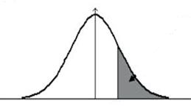
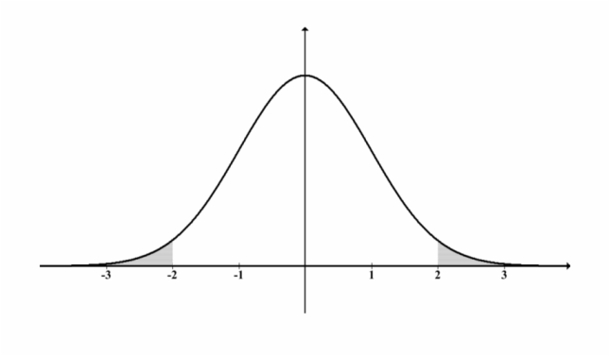
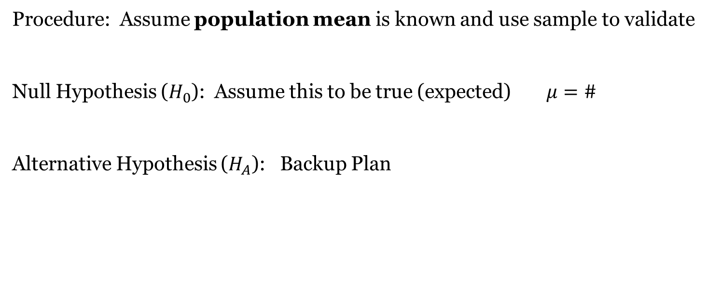
Hypothesis Test
Procedure: Assume population mean is known and use sample to validate
Null Hypothesis ($H_{0}$): Assume this to be true (expected)$μ=\#$
Alternative Hypothesis ($H_{A}$): Backup Plan
$$μ<\#$$
$$μ>\#$$
$μ≠\#$ (2-tailed)

Slide 6
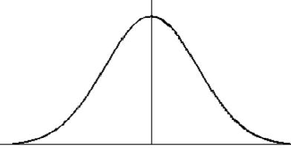
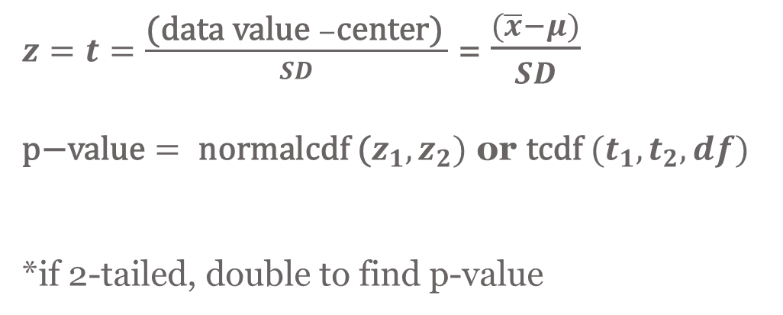
$z=t=\frac{\text{(}\text{data} \text{value} −\text{center}\text{)} }{SD}$ = $\frac{(\overline{x}−μ)}{SD}$ $\text{p}\text{−}\text{value}= \text{normalcdf}\text{ (}z_{1},z_{2})$ or $\text{tcdf} (t_{1},t_{2},df)$ *if 2-tailed, double to find p-value
Count = SD = $\frac{σ}{\sqrt{n}}$
Use z-distribution
Count = SE = $\frac{s_{x}}{\sqrt{n}}$
Use t-distribution
df = n - 1
$$μ$$
2nd VARS #2
2nd VARS #6

Slide 7
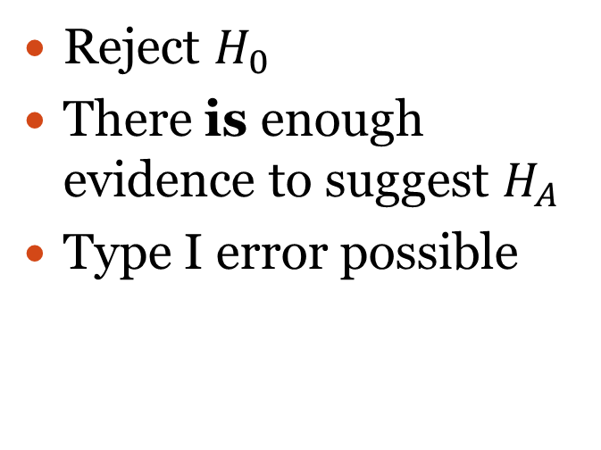
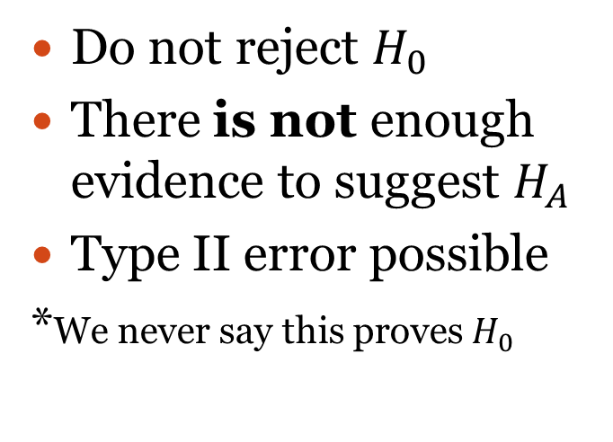
Conclusions
If p-value > alpha level
($\overline{x}$ expected)
If p-value < alpha level
($\overline{x}$ unusual)
Do not reject $H_{0}$
There is not enough evidence to suggest $H_{A}$
Type II error possible
*We never say this proves $H_{0}$
Reject $H_{0}$
There is enough evidence to suggest $H_{A}$
Type I error possible
p-value: probability of observing $\overline{x}$ when $H_{0}$ is assumed to be true

Slide 8
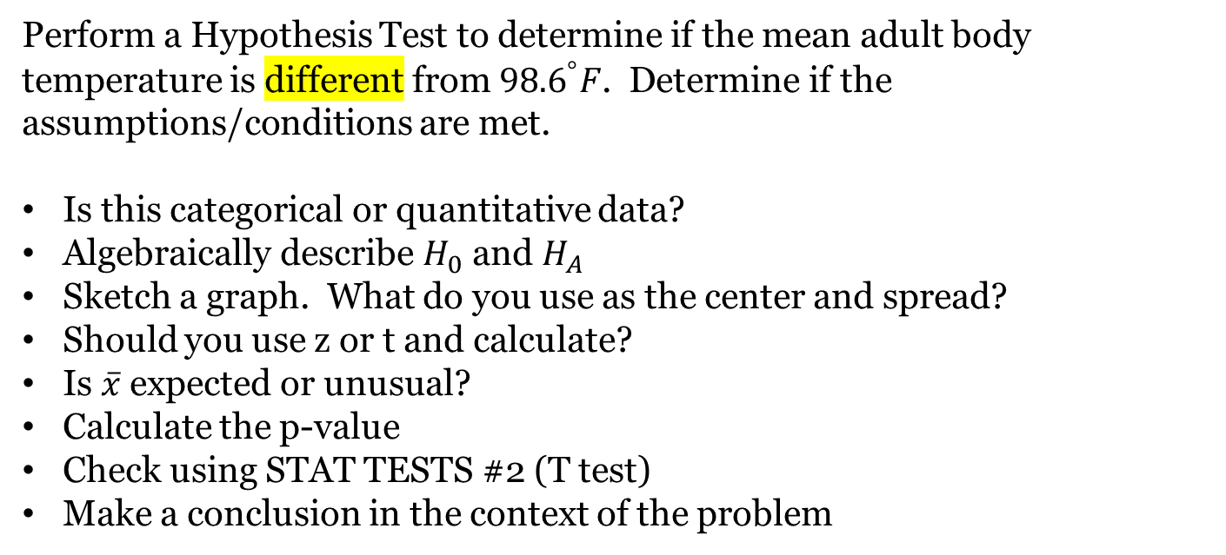
Ex 1: Mean Adult Body Temperature
Perform a Hypothesis Test to determine if the mean adult body temperature is different from ${98.6}^{°}F$. Determine if the assumptions/conditions are met.
Is this categorical or quantitative data?
Algebraically describe $H_{0}$ and $H_{A}$
Sketch a graph. What do you use as the center and spread?
Should you use z or t and calculate?
Is $\overline{x}$ expected or unusual?
Calculate the p-value
Check using STAT TESTS #2 (T test)
Make a conclusion in the context of the problem

Slide 9
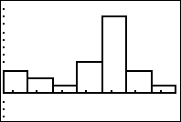
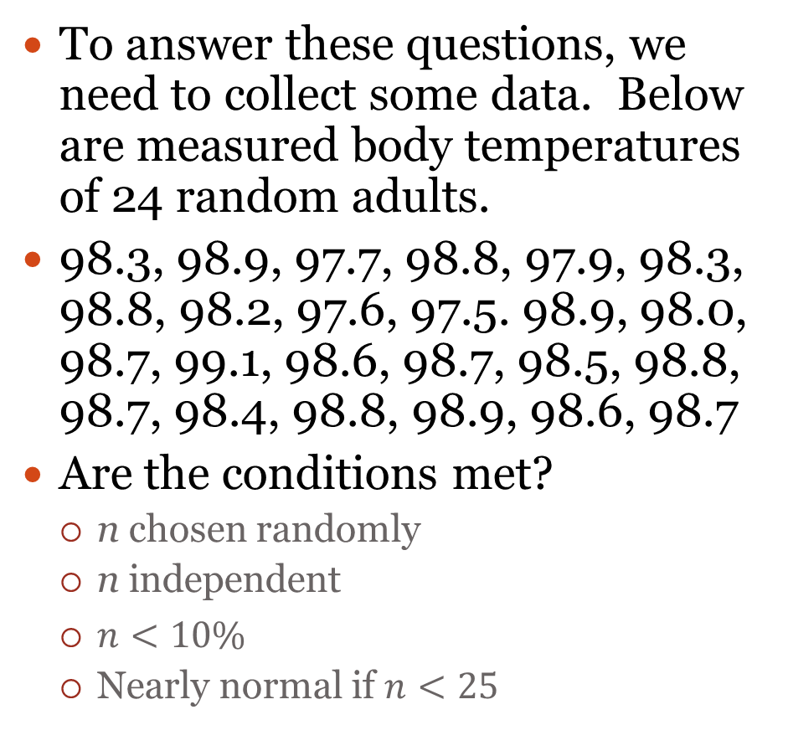
Ex 1
To answer these questions, we need to collect some data. Below are measured body temperatures of 24 random adults.
98.3, 98.9, 97.7, 98.8, 97.9, 98.3, 98.8, 98.2, 97.6, 97.5. 98.9, 98.0, 98.7, 99.1, 98.6, 98.7, 98.5, 98.8, 98.7, 98.4, 98.8, 98.9, 98.6, 98.7
Are the conditions met?
n chosen randomly
n independent
$n<10\%$
Nearly normal if $n<25$
STAT EDIT#1
STATPLOT #1
ZOOM #9

Slide 10
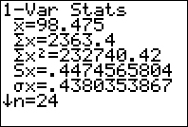
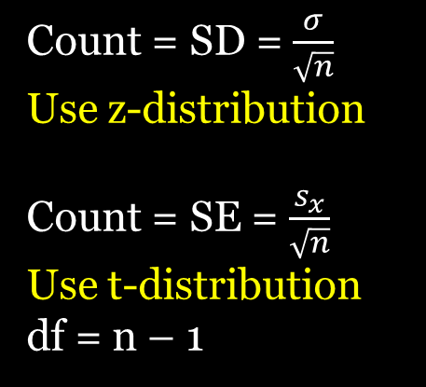
Ex 1
Is this categorical or quantitative data?
Algebraically describe $H_{0}$ and $H_{A}$
Sketch a graph. What do you use as the center and spread?
Should you use z or t and calculate?
Count = SD = $\frac{σ}{\sqrt{n}}$
Use z-distribution
Count = SE = $\frac{s_{x}}{\sqrt{n}}$
Use t-distribution
df = n – 1
$H_{0}: μ=98.6 H_{A}: μ≠98.6$two-tailed
$center=μ=98.6 S_{x}=0.447$ $\overline{x}=98.475$
$$SE=\frac{0.447}{\sqrt{24}}=0.0912434929≈0.09=count$$
STAT CALC #1
98.375
Mean Adult Body Temp
t-distribution
df= n-1 = 23
98.6
98.69
98.78
98.51
98.87
98.42
98.33

Slide 11
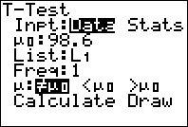
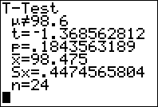
Ex 1
Is $\overline{x}$ expected or unusual?
Calculate the p-value
Check using STAT TESTS #2 (T test)
Make a conclusion in the context of the problem
STAT TESTS #2
$$t=\frac{data−center}{SD}=\frac{98.475−98.6}{0.09}=−1.39$$
$$p−value=2∗tcdf\left(−100,−1.39, 23\right)=0.1778365431$$
This is more than 5%, so we do not reject $H_{0}$ meaning there is not enough evidence to suggest that the mean adult body temperature is different from 98.6 degrees.
98.5
Mean Adult Body Temp
t-distribution
df= n-1 = 23
98.6
98.69
98.78
98.51
98.87
98.42
98.33

Slide 12
Ex 2: Valencia Class Size
Valencia college boasts about having small class sizes and states the average class size is 23 students on their webpage. From a random sample of 41 classes on East campus, the average number of students per class was 22.2 with a standard deviation of 4.2. Perform a hypothesis test to determine if it is different from reported by Valencia.

Slide 13
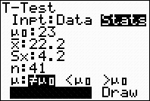
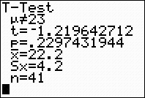
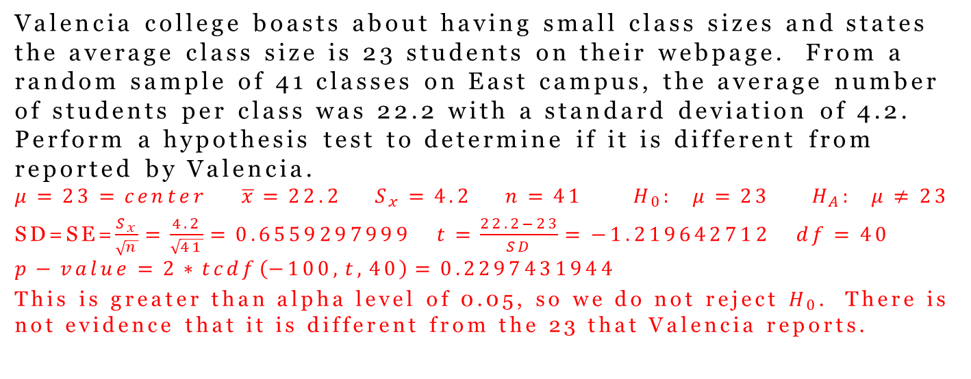
Ex 2: Valencia Class Size
Valencia college boasts about having small class sizes and states the average class size is 23 students on their webpage. From a random sample of 41 classes on East campus, the average number of students per class was 22.2 with a standard deviation of 4.2. Perform a hypothesis test to determine if it is different from reported by Valencia.
$$μ=23=center \overline{x}=22.2 S_{x}=4.2 n=41 H_{0}: μ=23 H_{A}: μ≠23$$
SD=SE=$\frac{S_{x}}{\sqrt{n}}=\frac{4.2}{\sqrt{41}}=0.6559297999 t=\frac{22.2−23}{SD}=−1.219642712 df=40$
$$p−value=2∗tcdf\left(−100,t,40\right)=0.2297431944$$
This is greater than alpha level of 0.05, so we do not reject $H_{0}$. There is not evidence that it is different from the 23 that Valencia reports.
Check using STAT TESTS #2

